Slide 1

Azure Reference Architectures
Session 06

Slide 2
AGENDA
Identity management
Hybrid network
Network DMZ
Managed web application
VM workloads
IoT
Data & AI

Slide 3
Reference architectures
Azure reference architectures are arranged by scenario, with related architectures grouped together.
Each architecture includes recommended practices, along with considerations for scalability, availability, manageability, and security.
Most also include a deployable solution.

Slide 4
Identity management

Slide 5
Identity management
These reference architectures show options for integrating your on premises Active Directory (AD) environment with an Azure network.
Consider this architecture
Integrate on-premises AD with Azure AD
Extend AD DS to Azure
Create an AD DS forest in Azure
Extend AD FS to Azure

Slide 6
Your application is hosted partly on premises and partly in Azure.
Azure Active Directory (Azure AD) is a cloud-based multi-tenant directory and identity service. This reference architecture shows best practices for integrating on-premises Active Directory domains with Azure AD to provide cloud-based identity authentication.

Slide 7
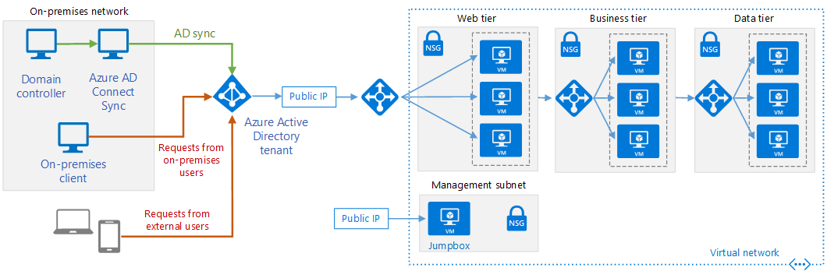
Integrate on-premises AD domains with Azure AD
Notes:
Integrate on-premises AD domains with Azure AD - Azure Reference Architectures | Microsoft Docs

Slide 8
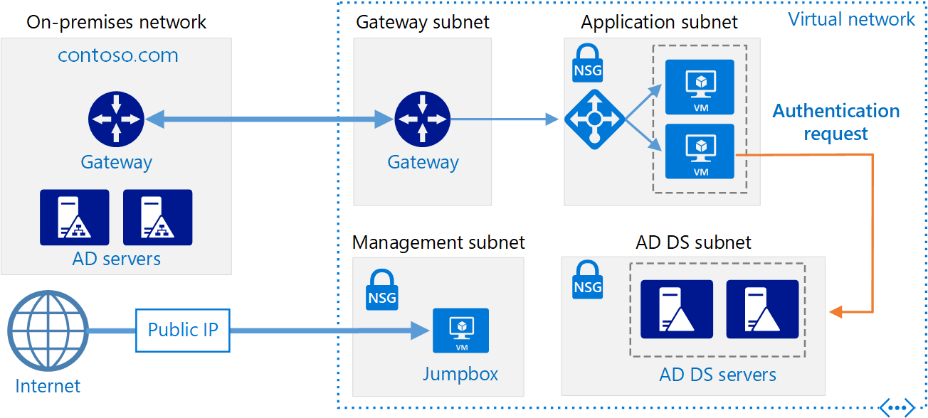
Extend AD DS to Azure
Notes:
Integrate on-premises AD domains with Azure AD - Azure Reference Architectures | Microsoft Docs

Slide 9
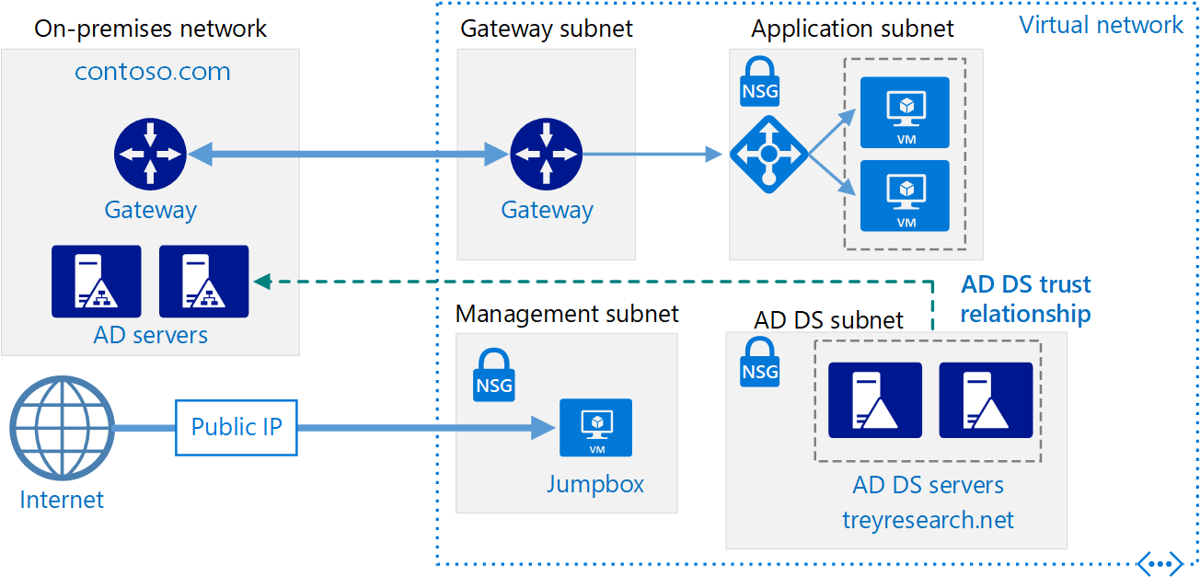
Create an AD DS forest in Azure
Notes:
Create an AD DS resource forest in Azure - Azure Reference Architectures | Microsoft Docs

Slide 10
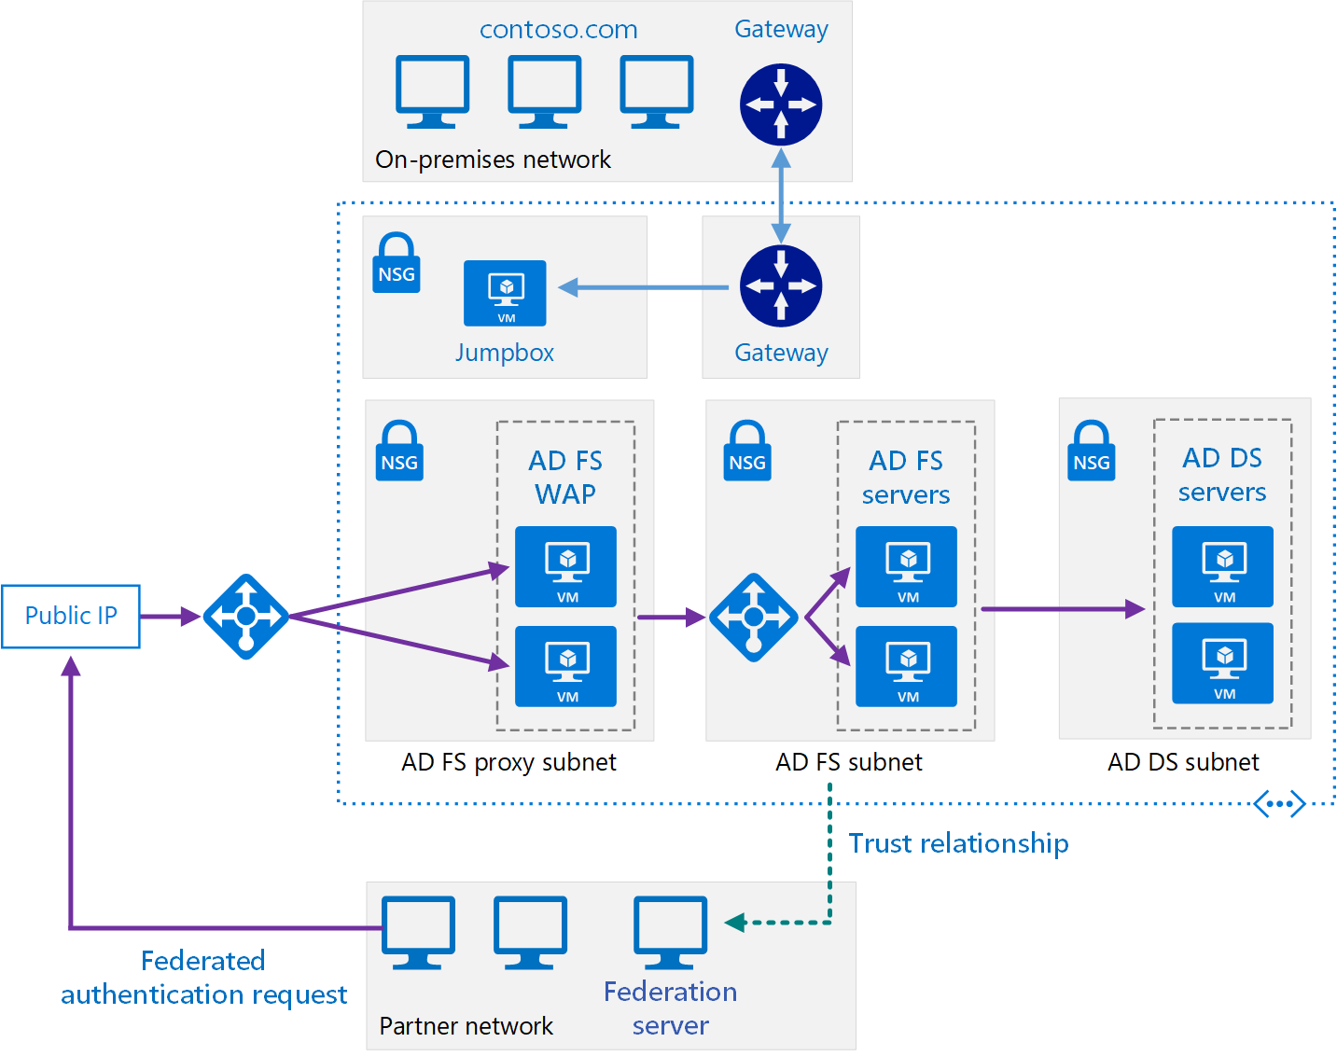
Extend AD FS to Azure
Notes:
Extend on-premises AD FS to Azure - Azure Reference Architectures | Microsoft Docs
Authenticate and authorize users
from partner organizations.
Allow users to authenticate from web
browsers running outside of the
organizational firewall.
Allow users to connect from
authorized external devices such as
mobile devices.

Slide 11
Your application is hosted partly on premises and partly in Azure.
Typical uses for this reference architecture include:
Web applications deployed in Azure that provide access to remote users who belong to your organization.
Implementing self-service capabilities for end-users, such as resetting their passwords, and delegating group management. This requires Azure AD Premium edition.
Architectures in which the on-premises network and the application's Azure VNet are not connected using a VPN tunnel or ExpressRoute circuit.

Slide 12
Hybrid Network

Slide 13
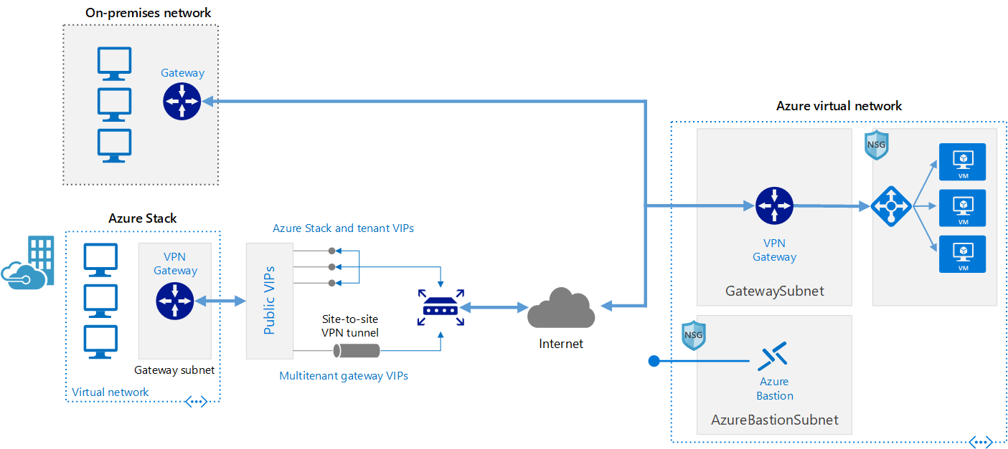
Extend an on-premises network using VPN
Notes:
Extend an on-premises network using VPN - Azure Architecture Center | Microsoft Docs
This reference architecture shows how to extend a network from on premises or from Azure Stack into an Azure virtual network, using a site-to-site virtual private network (VPN). Traffic flows between the on-premises network and Azure through an IPSec VPN tunnel or through the Azure Stack multitenant VPN gateway

Slide 14
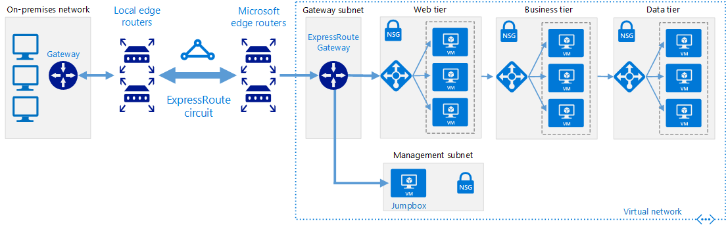
Extend an on-premises network using ExpressRoute
Notes:
Extend an on-premises network using ExpressRoute - Azure Architecture Center | Microsoft Docs
This reference architecture shows how to connect an on-premises network to virtual networks on Azure, using Azure ExpressRoute. ExpressRoute connections use a private, dedicated connection through a third-party connectivity provider. The private connection extends your on-premises network into Azure.

Slide 15
Managed web application

Slide 16
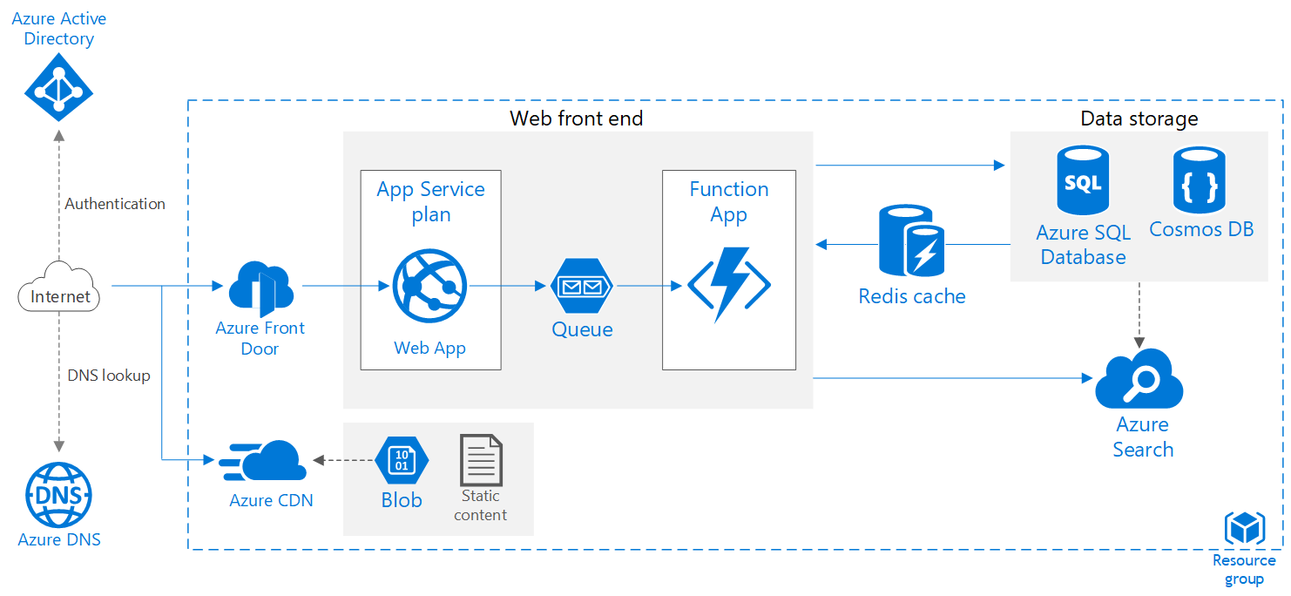
Scalable web application
Notes:
https://docs.microsoft.com/en-us/azure/architecture/reference-architectures/app-service-web-app/scalable-web-app
This reference architecture shows proven practices for improving scalability and performance in an Azure App Service web application.

Slide 17
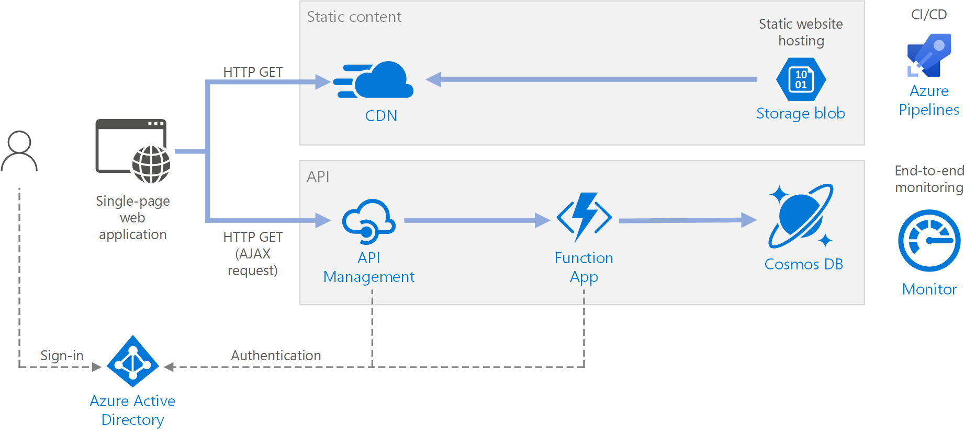
Serverless web application
Notes:
https://docs.microsoft.com/en-us/azure/architecture/reference-architectures/serverless/web-app
This reference architecture shows a serverless web application. The application serves static content from Azure Blob Storage, and implements an API using Azure Functions. The API reads data from Cosmos DB and returns the results to the web app.

Slide 18
VM workloads

Slide 19
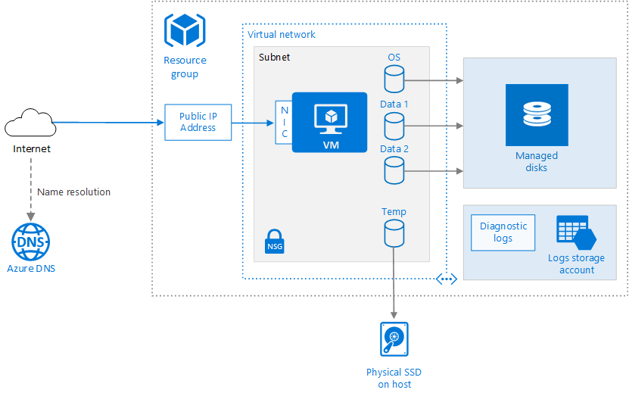
Run a Windows |Linux VM on Azure
Notes:
Provisioning a virtual machine (VM) in Azure requires some additional components besides the VM itself, including networking and storage resources. This article shows best practices for running a Windows VM on Azure.

Slide 20
Internet Of Things

Slide 21
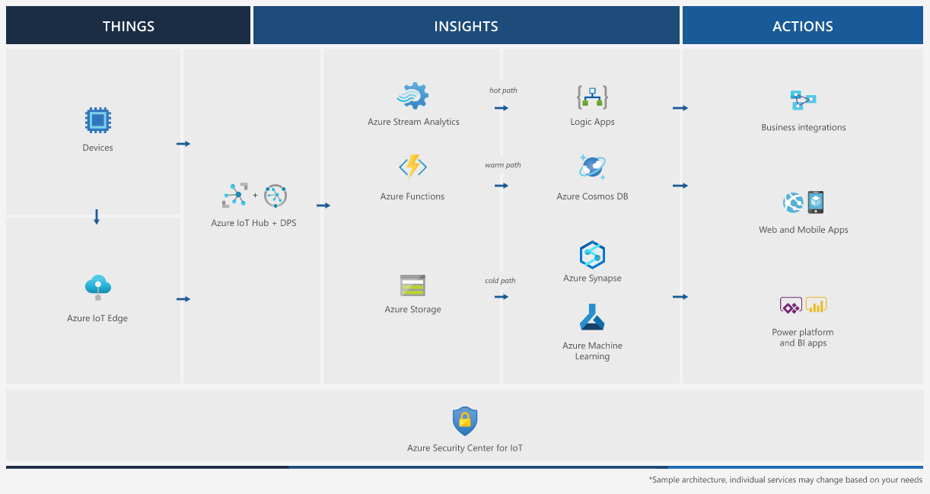
Azure IoT reference architecture

Slide 22
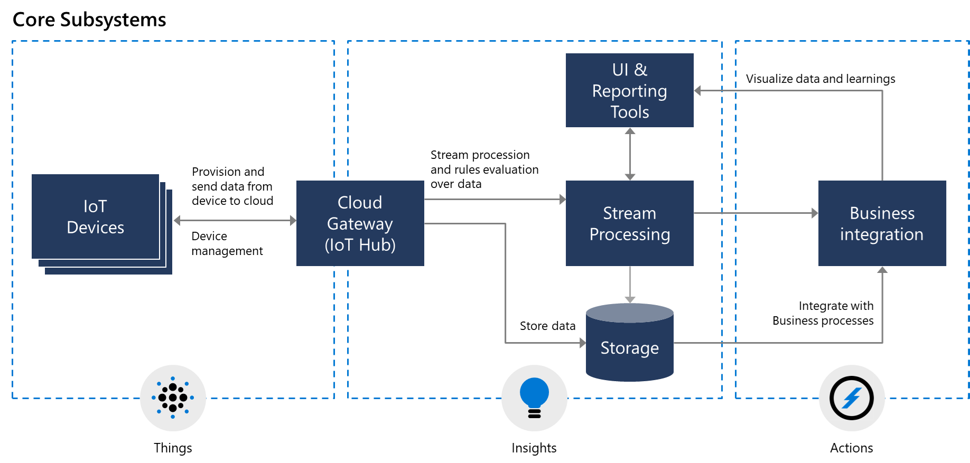
Core subsystems of an IoT architecture

Slide 23
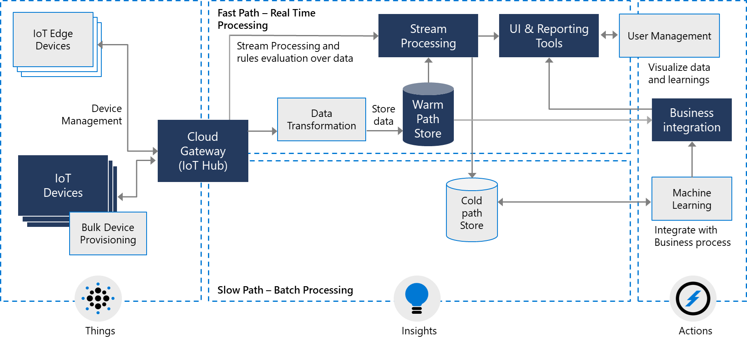
Optional subsystems of an IoT architecture

Slide 24
Data & AI

Slide 25
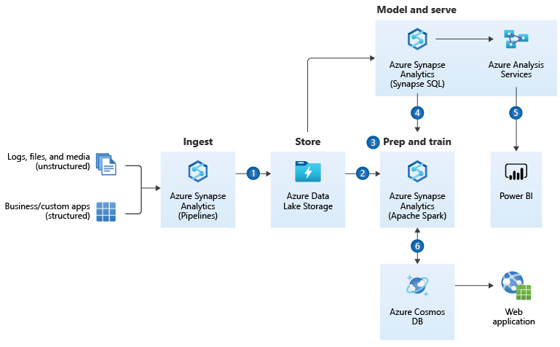
Advanced Analytics Architecture

Slide 26
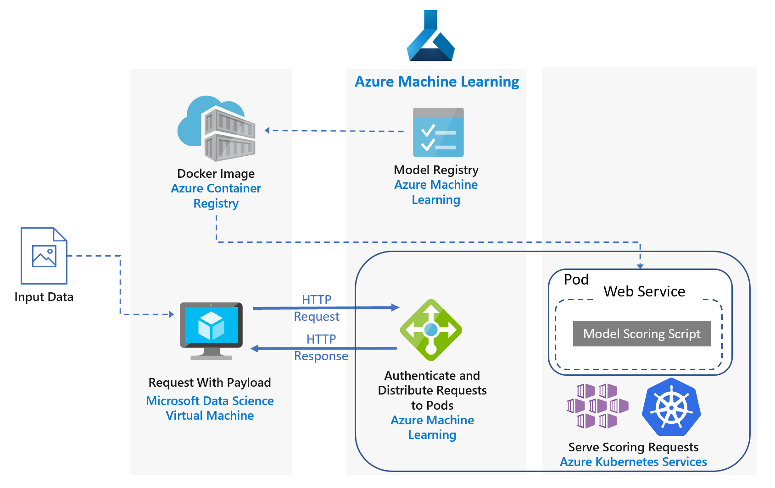
Real-time scoring of Python models
Notes:
https://docs.microsoft.com/en-us/azure/architecture/reference-architectures/ai/realtime-scoring-python
This reference architecture shows how to deploy Python models as web services to make real-time predictions using the Azure Machine Learning. Two scenarios are covered: deploying regular Python models, and the specific requirements of deploying deep learning models. Both scenarios use the architecture shown.

Slide 27
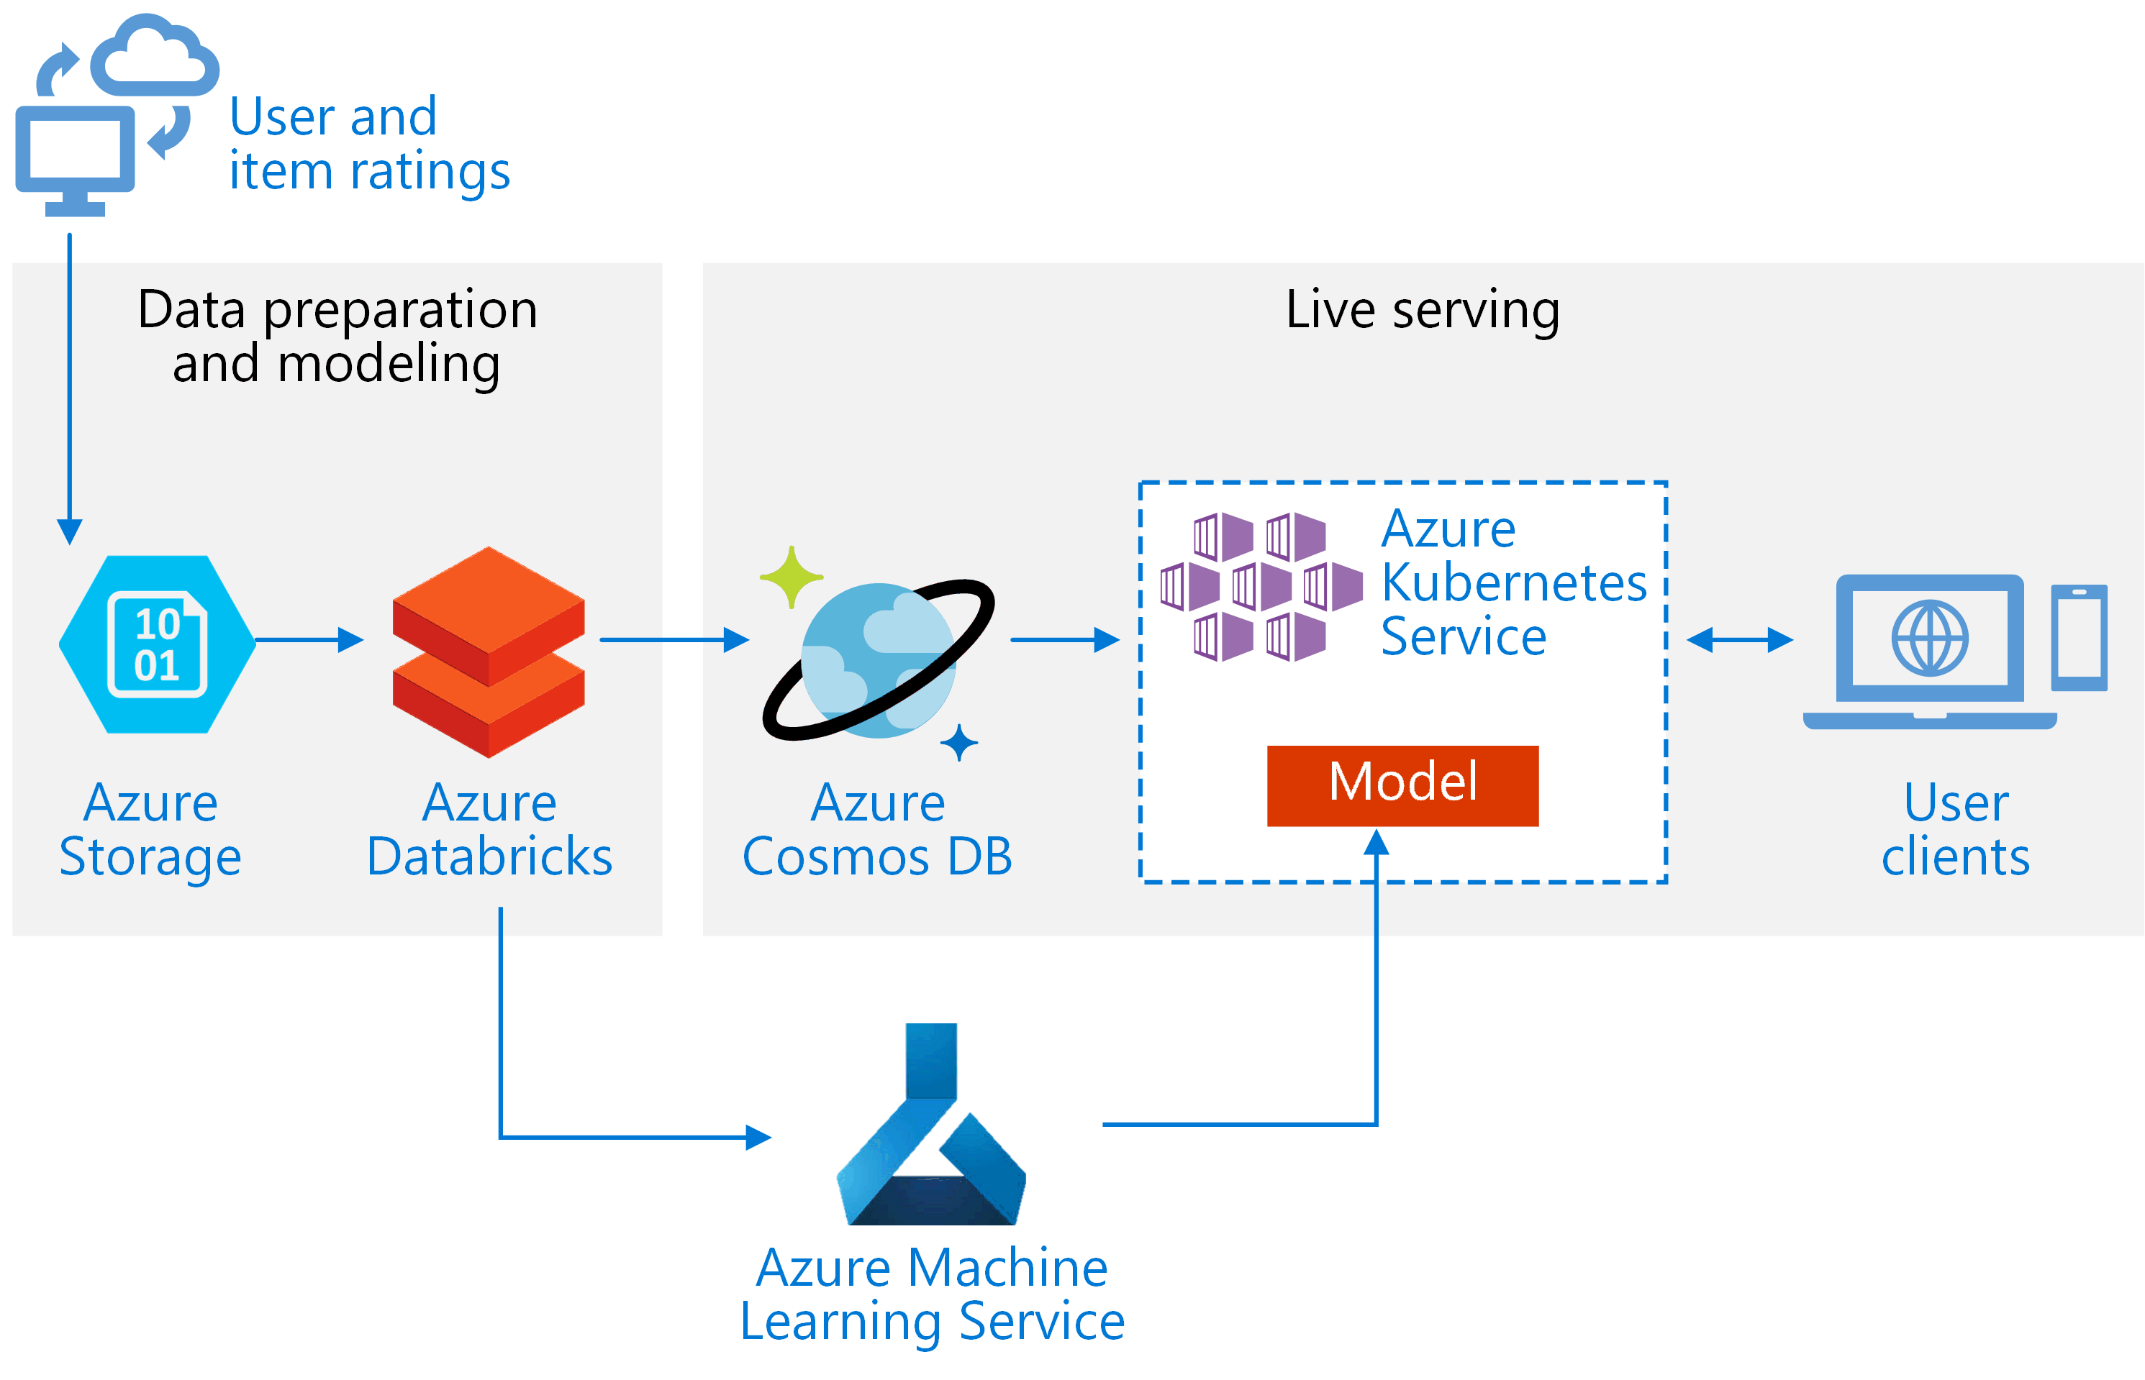
Real-time recommendation API on Azure
Notes:
This reference architecture shows how to train a recommendation model using Azure Databricks and deploy it as an API by using Azure Cosmos DB, Azure Machine Learning, and Azure Kubernetes Service (AKS). This architecture can be generalized for most recommendation engine scenarios, including recommendations for products, movies, and news.

Slide 28
Thank You
Q & A

